Slide 1

VMware Automation
- PowerCLI
Alan Renouf Product Manager
CLIs and Automation Frameworks
© 2014 VMware Inc. All rights reserved.

Slide 2


Introduction
Alan Renouf – Product Manager, VMware
VMware Blog: http://blogs.vmware.com/PowerCLI/ Personal Blog: http://virtu-al.net/
Twitter: @alanrenouf
“My Job is to make automation easier for you”

Slide 3
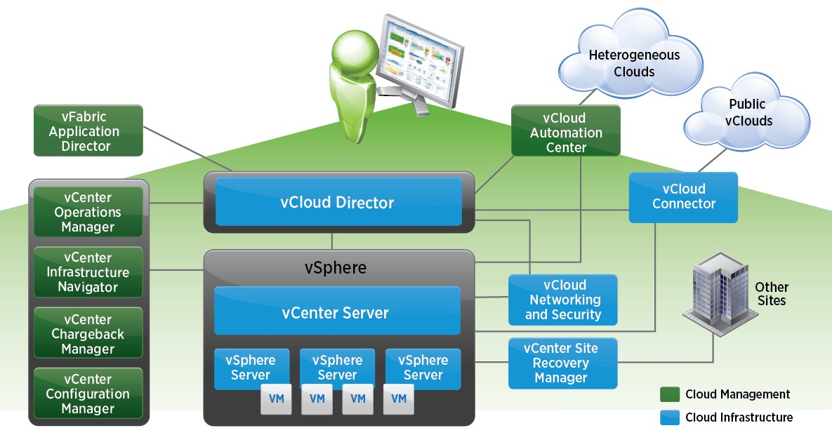

What is this VMware stuff?

Slide 4
Question
▪▪ Do you wish you could hand off menial tasks to others?
▪▪ Do you perform the same task day in, day out?
▪▪ Do you have a check list each morning ?
▪▪ Do you need to perform tasks on mass ?
▪▪ Do you wish you could export vCenter Information?
▪▪ Do you love documentation ?

Slide 5


Automation Definitions
▪▪ Automation:
▪▪ Scripts-based:
Need to type text (correctly)
▪▪ Workflow-based:
IT Process Automation, Orchestration, Run Book Automation
▪▪ Built-in:
Purpose-built application or feature (e.g. HA)
▪▪ Policy/Event based:
Define rules without code in UI (e.g. vMotion)
▪▪ Related concepts:
APIs, Integration

Slide 6
VMware Automation Cheat Sheet

Slide 7



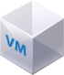

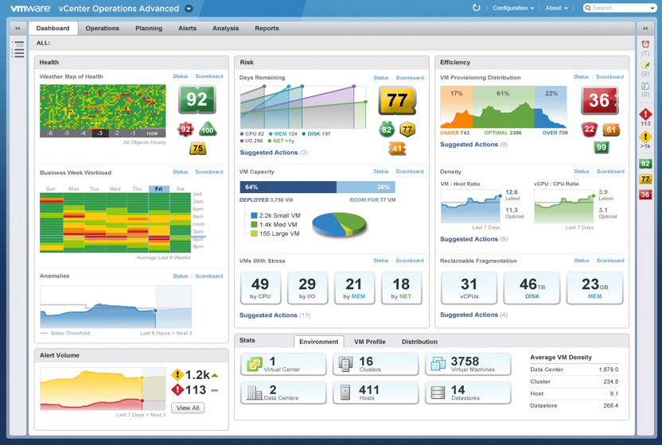
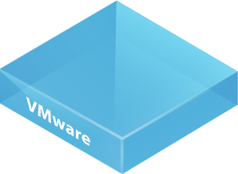
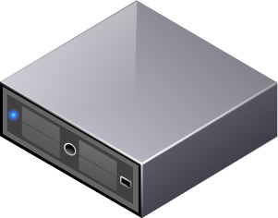



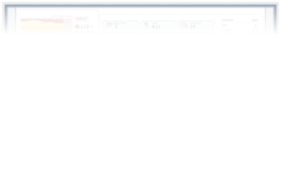
Areas of Automation
Provisioning
Datacenter Infrastructure Virtual Datacenter
VMs Applications Workloads Desktops
Operations
Detection of failures Availability
Health Scaling/Rightsizing Capacity Remediation Resource Allocation Failover
Maintenance
Administrative tasks Updates / Upgrades Reporting
Ongoing Configuration

Slide 8

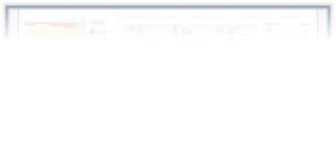
What VMware Products COULD you Use?
Provisioning
Datacenter Infrastructure vCAC/VCO/PowerCLI Virtual Datacenter vCD/VCNS
VMs
AppD/vCAC/vCO/PowerCLI/vCenter Applications AppD/vCAC/vCO/PowerCLI Workloads
vCAC/vCO/PowerCLI
Desktops
vCAC/View
Operations
Detection of failures vCOps Mgr/PowerCLI Availability
vCOps
Health
vCOps Mgr/PowerCLI Scaling/Rightsizing vCOps/vCO/PowerCLI/vCAC/AppD Capacity
vCOps Mgr/PowerCLI
Remediation
vCO/PowerCLI Resource Allocation vSphere DRS/SDRS Failover
vSphere HA/SRM
Maintenance
Administrative tasks vCO/PowerCLI Updates / Upgrades
VUM/VCM/VCO/PowerCLI
Reporting
PowerCLI/vCOps Mgr Ongoing Configuration VCM/AppD/vCAC

Slide 9
What VMware Products ARE Recommended?
Provisioning
Datacenter Infrastructure vCAC/vCO/PowerCLI Virtual Datacenter vCD/VCNS
VMs
AppD/vCAC/VCO/PowerCLI/vCenter Applications AppD/vCAC/vCO/PowerCLI Workloads
vCAC/vCO/PowerCLI
Desktops
vCAC/View
Operations
Detection of failures vCOps Mgr/PowerCLI Availability
vCOps Mgr
Health
vCOps Mgr/PowerCLI Scaling/Rightsizing vCOps/vCO/PowerCLI/vCAC/AppD Capacity
vCOps Mgr/PowerCLI
Remediation
vCO/PowerCLI Resource Allocation vSphere DRS/SDRS Failover
vSphere HA/SRM
Maintenance
Administrative tasks vCO/PowerCLI Updates / Upgrades
VUM/VCM/vCO/PowerCLI
Reporting
PowerCLI/vCOpsMgr Ongoing Configuration VCM/AppD/vCAC
(If you use something else and it works, great!)

Slide 10
vCloud Automation Center

Slide 11
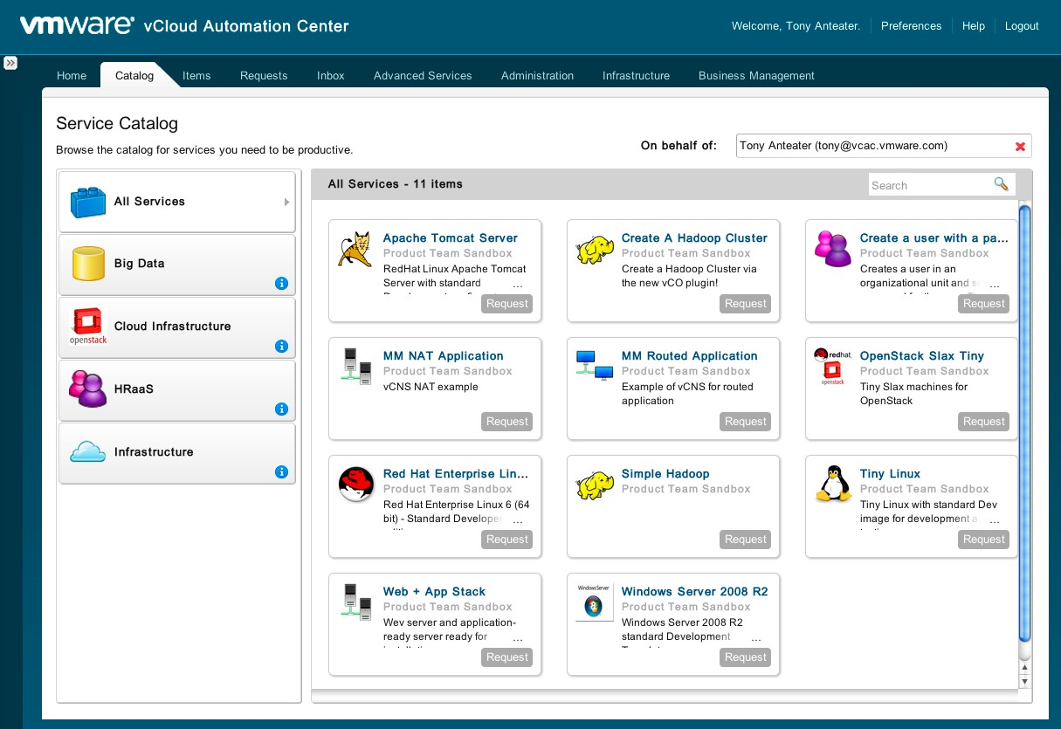
vCloud Automation Center - QUICK FACTS
▪▪ Automation Technology
Built-in & policy based
▪▪ Target User
Cloud Administrator
Service Architect
Consumers of IT services
▪▪ Particularly good for…
Self-service
Service lifecycle management

Slide 12




















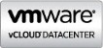




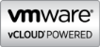




vCAC – Self Service Automation
vCloud Automation Center
IaaS
Approvals
DaaS
Service Tiers
PaaS
Policies
XaaS
Service Blueprints
Security
vCloud Director (optional)
vCloud Service Providers
Other Service Providers
Other Hyper- visors
Hardware
Other Management Systems
vCenter Operations Mgmt
IT
Business Mgmt
vCenter Orchestrator
Software Defined Networking & Security
Software Defined Storage & Availability
CMDB DNS IPAM
Load balancers
Service Desk Monitoring Databases Etc.
vSphere

Slide 13
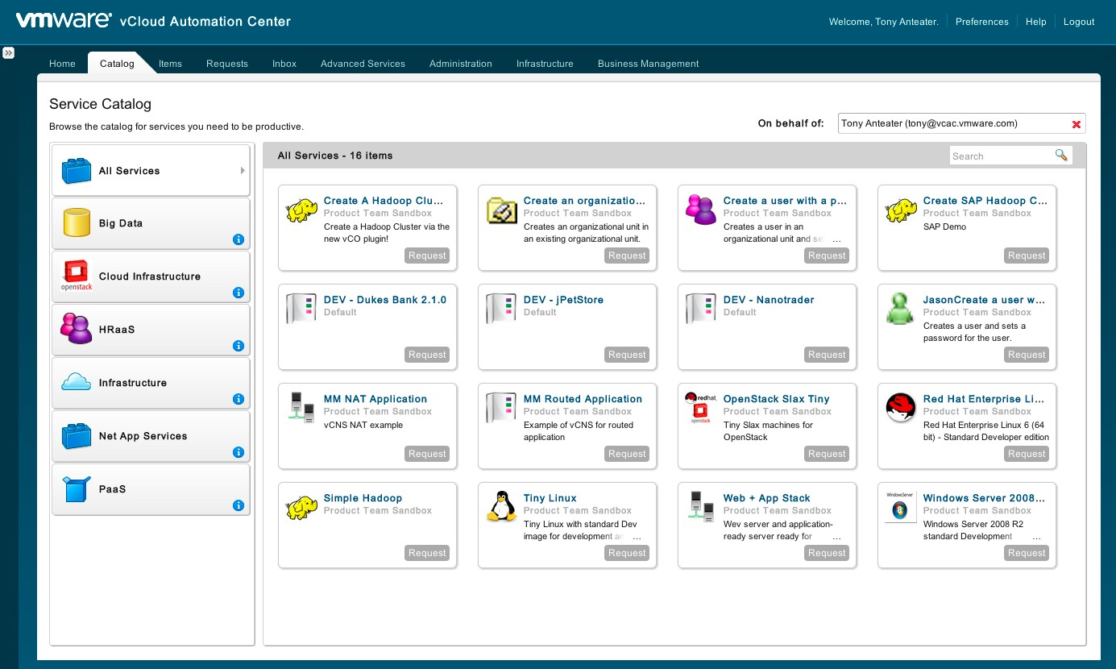



Request any IT service via a unified portal
App store experience
Custom Service
Service category
Flexible and powerful Entitlements and Approvals policies
Extensible to new services

Slide 14
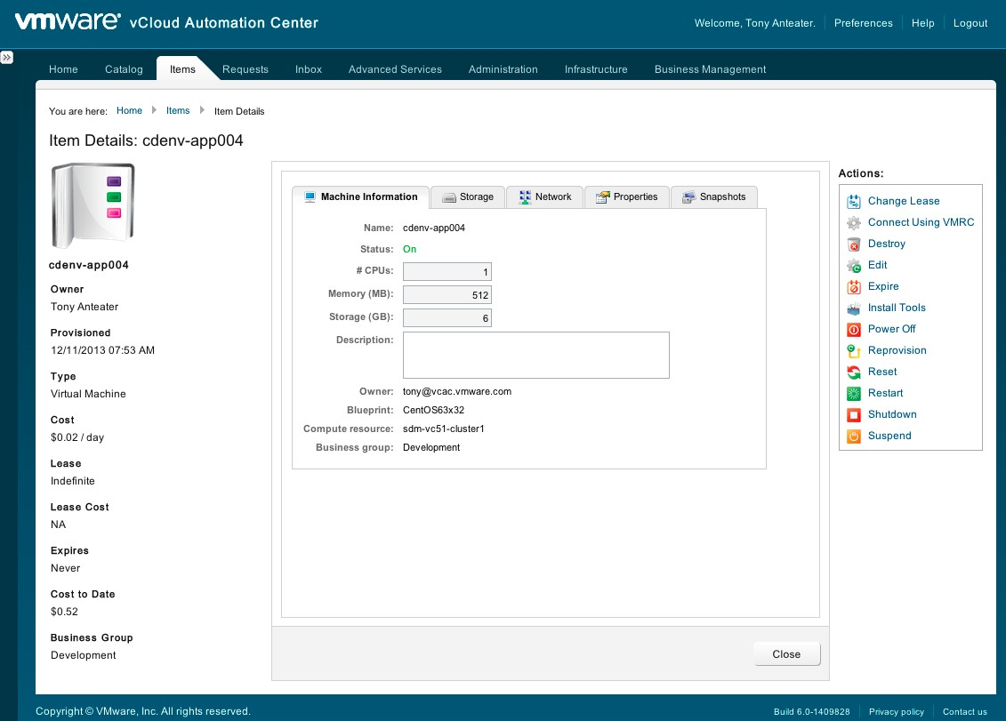

Perform basic management tasks via the portal
Context specific actions on resources provisioned for this user. Controlled by entitlements.
Extensible with new services.

Slide 15
vCenter Orchestrator

Slide 16
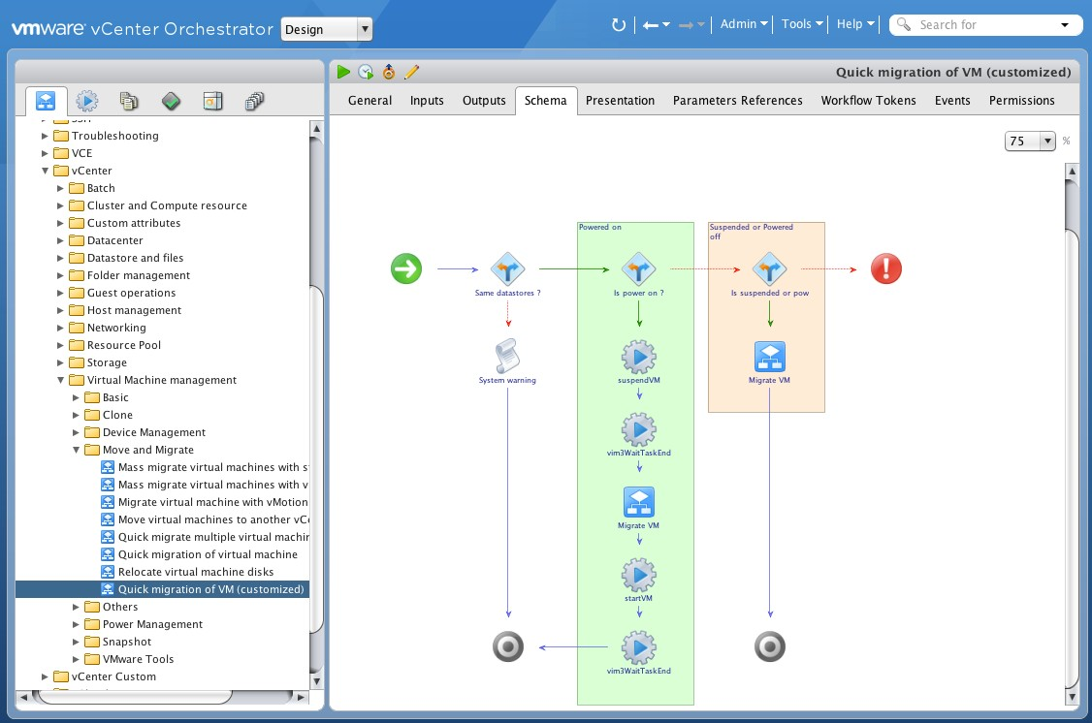
vCenter Orchestrator - QUICK FACTS
▪▪ Automation Technology
Workflow
▪▪ Target User
Automation Specialist
Integration Engineer
vSphere Administrator
▪▪ Particularly good for…
Multi-system automation
3rd party integration

Slide 17

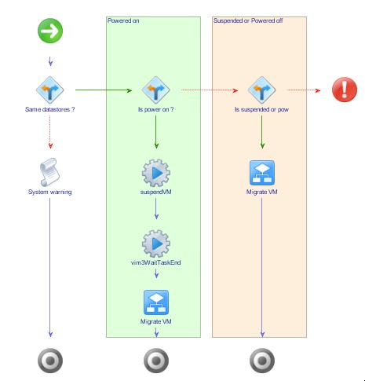




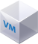
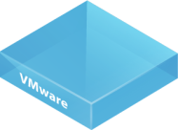
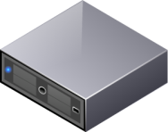







vCenter Orchestrator Overview
Features
Drag-&-drop design
Create powerful workflows easily by drop-&-dragging pre- built actions
Platform
Cloud scalability
Execute hundreds of workflows in parallel to meet Cloud scale
vSphere
Ecosystem
Plug-ins
Flexible triggers
Launch workflows from the vSphere Web Client, vCAC, web browser, schedule, event, and API
Features
Integrate VMware solutions into your IT environment and processes
Reduce IT OpEx and total cost of ownership of VMware solutions
Automate your cloud and accelerate transition to “IT as a Service” model
Automate VMware
100% coverage of vSphere and vCloud Director APIs
Unmatched VMware content
Included with vCenter Server
Included with vSphere at no extra cost
Installed with vCenter

Slide 18
Thousands of out of the box workflows & actions
VMware Applications
vCenter Server 4.0, 4.1, 5.0,5.1,5.5
vCloud Director 1.0, 1.5, 5.1 & 5.5
vCloud Automation Center 5.1, 5.2
vCenter Update Manager 4.1, 5.0 & 5.1
vCenter Chargeback 2.0
vCenter Configuration Manager 5.5
vCenter Operations Manager Package
vCenter Orchestrator Multinode 5.0 & 5.1
vSphere Auto Deploy
VMware Service Manager 9.1
VMware Service Elasticity
Standard Protocols
AMQP / RabbitMQ
Email (POP3 and SMTP)
HTTP-REST
JDBC
SOAP
SNMP v1, v2c and v3
SQL
SSH
Telnet
XML
Partner Applications
Bluecat Networks
BMC Atrium CMDB & Remedy
Cisco UCS Manager 1.3
EMC Unified Infrastructure Manager
EMC ViPR
Egenera PAN Manager
F5 Networks
Infoblox NIOS
Microsoft Active Directory
Microsoft Windows PowerShell
NetApp WFA
Radware vDirect
ServiceNow
Up.time Software
Under development !!!
Cisco UCS Manager 2.x (beta available)
Hitachi Unified Compute Platform
HP ServiceManager
VMware vCNS and NSX
VMware Site Recovery Manager
And more to come…

Slide 19
vSphere PowerCLI

Slide 20
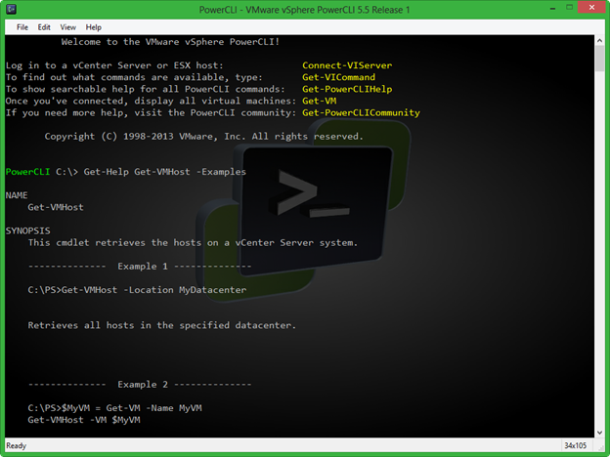
PowerCLI - QUICK FACTS
▪▪ Automation Technology
Scripting
▪▪ Target User
vSphere Administrator
Automation Specialist
▪▪ Particularly good for…
Quick Administrative tasks
Fire and fix
Reporting
Prototyping

Slide 21

PowerCLI - Overview
▪▪ PowerCLI Overview
Integrated into Windows PowerShell
Designed towards system administrators not developers
Installed by default from Windows 2008/2012 Windows 7
(XP/2003 requires download)
Extending the existing PowerShell knowledge of Windows Admin
Easily integrated with other Microsoft, VMware and 3rd Party Snapins
PowerCLI is a free product containing over 410+ cmdlets (PowerShell Commands)
Manage every public aspect of:
VMware vSphere
VMware vCenter Server
VMware vCloud Director (PowerCLI 5.0.1 onwards)
VMware View
VMware Update Manager
vSphere Site Recovery Manager (New in 5.5 R2)
PowerCLI is backward compatible all the way to ESX 4.1 U3 / Virtual Center 4.1 U3

Slide 22



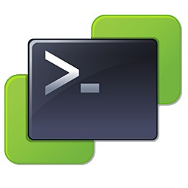





PowerCLI Command sets (Snap-in’s)
▪▪ Core
Managing vSphere and SRM
▪▪ Image Builder
Working with Image Profiles
▪▪ Auto Deploy
Deploying ESXi via PXE
▪▪ License
Working with vSphere Licensing
▪▪ Cloud
vCloud Director Providers
▪▪ Tenant
vCloud Director Tenants
▪▪ VDS
vSphere Distributed Switches
vSphere Core
Site Recovery Manager
vCloud Director
vSphere Distributed Switch
License
Image Builder
Auto Deploy
vCloud Tenant

Slide 23
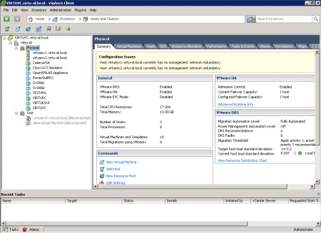
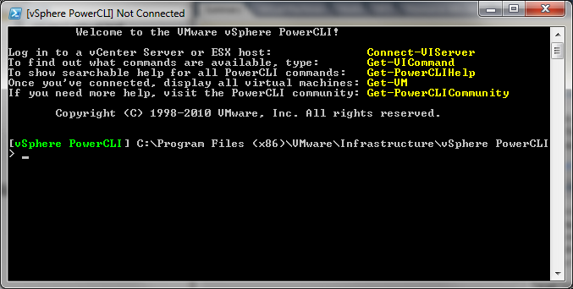
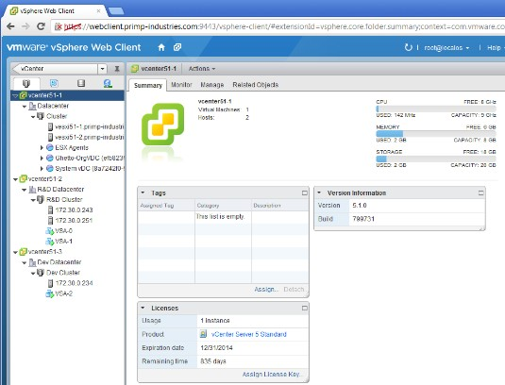

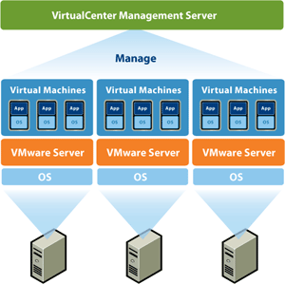
Where does PowerCLI fit in ?
vSphere Client / Web Client
PowerCLI
Virtual Center APIs

Slide 24
PowerCLI - Overview
▪▪ PowerCLI Cmdlet syntax
All cmdlets use a Verb-Noun syntax, examples are:
Get-VM (Lists all VMs) | Get-Datastore (Lists all Datastores)
New-VM (Creates new VMs) | Start-VM (Powers on VMs)
New-VMHost (Adds Hosts) | Stop-VM (Powers off a VMs)
Set-Snapshot (alters snapshot information) | Remove-VMHost (Removes Hosts)
New-Datatsore (Creates new Datastores) | Remove-Cluster (Removes Clusters)
▪▪ “Piping”
Allows the output of one cmdlet to be used by another
Powerful one-line code solutions
Get-­‐Cluster Cluster1 | Get-­‐VM
▪▪ Built-in cmdlet help and examples
Available from the PowerCLI prompt via Get-Help and online
Examples of common tasks by using Get-Help cmdletname –Examples

Slide 25
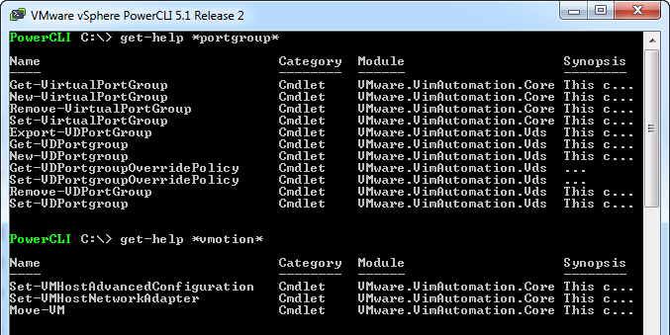
Where do I start ?
Learning PowerCLI is very easy !
Get-Help
Get-Command

Slide 26
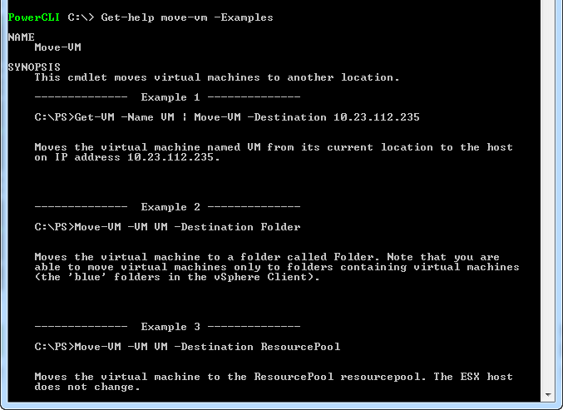
Where do I start ?
Learning PowerCLI is very easy !
Examples

Slide 27




Integration
One script can work with many products
PowerShell Snapins
Compute/Storage/Networking/Applications
PowerShell Modules
Compute/Storage/Networking/Applications
COM Connections
REST API
Internet Explorer
Database connections

Slide 28
PowerCLI - Reporting

Slide 29
PowerCLI - Reporting
“Get-” cmdlets retrieve data
Safe place to start with PowerCLI as your only retrieving data
Use built in PowerShell cmdlets to export the data
Export a list of all VMs to a csv file
Get-­‐VM | Export-­‐CSV –File C:\Exports\AllVMs.csv
Export all hosts in ClusterA details to a html file
Get-­‐Cluster ClusterA | Get-­‐VMHost | ConvertTo-­‐Html | Out-­‐File C:
\Exports\HostsinClusterA.html
Export Datastore Information to Excel Spreadsheet (requires extra function)
Get-­‐Datastore | Export-­‐Xls Datastores.xls …

Slide 30


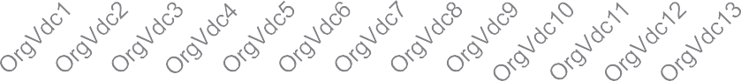



PowerCLI - Reporting
Monitor Organization vDCs in a specific Provider vDC for opportunities to upgrade them to higher service level
Get-­‐OrgvDC -­‐ProviderVdcName "Development"`
| Select Name, CpuLimitGhz, CpuUsedGhz, MemoryLimitMB, MemoryUsedMB, StorageLimitMB, StorageUsedMB
| Export-­‐Xls Development_Threshold.xls …
14.00
12.00
10.00
8.00
CpuLimitGhz CpuUsedGhz
6.00
4.00
2.00
-
140000
120000
MemoryLimitMB
100000
80000
60000
40000
20000
MemoryUsedMB
350000
300000
250000
StorageLimitMB
0
200000
150000
100000
50000
0
StorageUsedMB

Slide 31
Demo
How to draw out your complete environment…

Slide 32
PowerCLI - Provisioning

Slide 33
PowerCLI - Provisioning
▪▪ Easily provision new VMs/Hosts/Datastores/Clusters/Datacenters/Clouds
Create a new VM from template and apply a customization specification
New-­‐VM -­‐Name VM2 -­‐Template “Windows2008” -­‐VMHost ESX01 -­‐ OSCustomizationSpec “Spec1”
Create 100,1000 or 1000000 new VMs from template and put on a random host
1..100 | Foreach { New-­‐VM -­‐Name VM$_ -­‐Template “Windows2008” –VMHost (Get-­‐VMHost | Get-­‐Random) -­‐OSCustomizationSpec “Spec1” }
Add a new Cluster
New-­‐Cluster -­‐Location (Get-­‐Datacenter DC01) -­‐Name Cluster01 -­‐DRSEnabled
-­‐DRSMode FullyAutomated –HAEnabled –HAFailoverLevel 1
Create a snapshot on all VMs in a Cluster before patching
Get-­‐Cluster Cluster01 | Get-­‐VM | New-­‐Snapshot –Name “Before Patching.”
-­‐Description “Created on $date before patching the VM”

Slide 34
PowerCLI – In Guest Operations

Slide 35
PowerCLI – In Guest operations
▪▪ Use VMware VIX (part of VMTools) to perform in guest operations
•Retrieve data from the guest operating system
•Run scripts inside the guest operating system
•Works with both Windows and Linux
List the directory entries inside the guest OS
Invoke-­‐VMScript -­‐VM VM -­‐ScriptText "dir“ -­‐GuestUser administrator
-­‐GuestPassword pass2
Copy files from the local machine into the guest file system
Get-­‐Item "c:\FolderToCopy\*.*" | Copy-­‐VMGuestFile -­‐Destination "c:\MyFolder" -­‐VM $vm -­‐LocalToGuest -­‐GuestUser administrator
-­‐GuestPassword pass2
Backup a file on a linux guest
Invoke-­‐VMScript -­‐VM VM1 -­‐ScriptText "mv /common/configs/file.conf / common/configs/file.conf.bak" -­‐ScriptType Bash -­‐GuestUser GuestUser -­‐ GuestPassword GuestPass

Slide 36
PowerCLI – What's New in 5.5 R2?

Slide 37
PowerCLI 5.5 R2 – What’s New
Manage vCenter Site Recovery Manager
Create and remove tags and tag categories
Retrieve information and configure Enhanced vMotion Compatibility (EVC) mode on clusters.
Manage security policies for vSphere standard switches and port groups.
Support for Windows PowerShell 4.0.
Support for vSphere servers configured with IPv6.
Specify the priority of a VM migration
Provide a Hard Disk object to the RelatedObject of Get-Datastore
Get-Datastore cmdlet to allow filtering by cluster.
Get-Stat and Get-StatType now works with all types
Added support for e1000e network adapter type.
Specify all values for DiskStorageFormat when cloning a virtual machine
64-Bit Support for New-OSCustomizationSpec and Set-OSCustomizationSpec
ToolsVersion property to VMGuest that shows the version as a string.
Provide a virtual portgroup to the RelatedObject of the Get-VirtualSwitch and Get-DVSwitch
Retrieve virtual machines by virtual switches.
Other bug fixes and general performance enhancements have been made to various PowerCLI cmdlets.

Slide 38
PowerCLI - Advanced

Slide 39
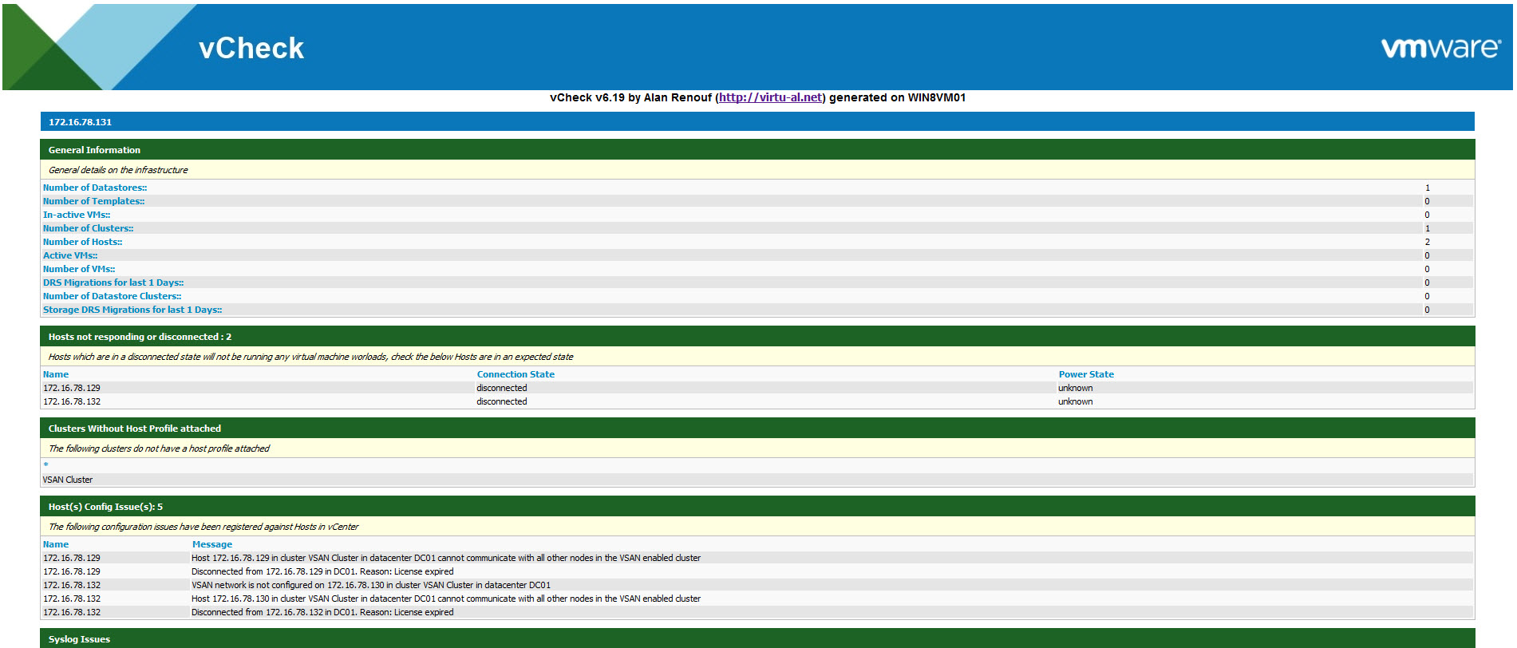
PowerCLI – Advanced Scripts
▪▪ Advanced scripts have been created by the PowerCLI community and are free to download… vCheck – A script to make you aware of any issues in your infrastructure

Slide 40
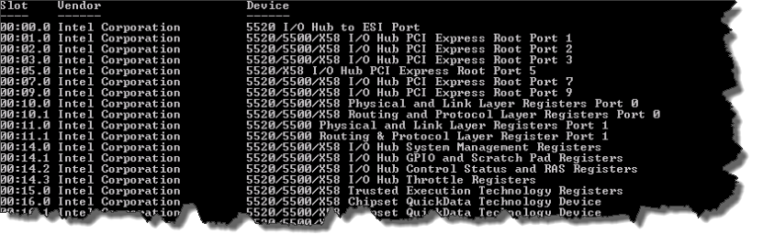
PowerCLI – Advanced Scripts
▪▪ Advanced scripts have been created by the PowerCLI community and are free to download…
Name that hardware – A script for detailed hardware information (lucd.info)

Slide 41


Type of Cmdlets
Low Level
$spec = new-­‐object VMware.Vim.VirtualMachineConfigSpec
$spec.MemoryAllocation = New-­‐Object VMware.Vim.ResourceAllocationInfo
$spec.MemoryAllocation.Limit = -­‐1
$vm = get-­‐view -­‐ViewType VirtualMachine -­‐Filter @{"Name"="VM001"}
$vm.ReconfigVM_Task($spec)
High Level
Get-­‐VM VM001 | Get-­‐VMResourceConfiguration | Set-­‐VMResourceConfiguration -­‐ MemLimitMB $null
CONFIDENTIAL
41

Slide 42
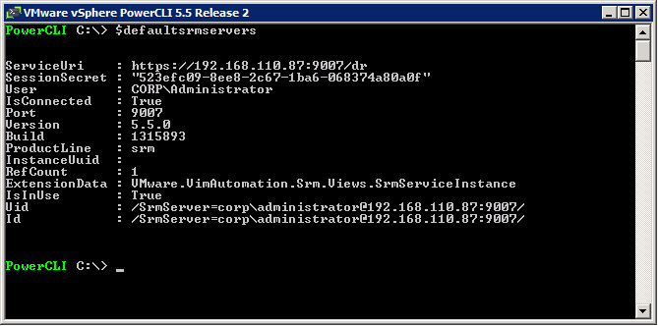
How the SRM Cmdlets relate to the API
Connect-­‐SRMServer
-> Connects to the SRM Server attached to vCenter and creates $Global:defaultSRMServers
$defaultSRMServers
-> Stores an array of connected SRM Servers which we can use for our scripts

Slide 43











































How the SRM Cmdlets relate to the API
$defaultSRMServers[0].extensiondata
Authentication
-> SRM API
LoginLocale() LoginSites() LogoutLocale()
ServiceInstance
RetrieveContent()
Protection
.
ListProtectionGroups() ListInventoryMappings() ListReplicatedDatastores()
..more
..more
MoRef
Method = Turn Right
Property = Red
Recovery
.
..more
ListPlans() GetHistory()
Check out the Site Recovery Manager API Developers Guide https://www.vmware.com/support/developer/srm-api/srm_50_api.pdf
..more
MoRef

Slide 44
Site Recovery Manager – Example
Connect-SrmServer
$SRMAPI = $DefaultSRMServers[0].Extensiondata
$protectionGroups = $srmApi.Protection.ListProtectionGroups()
$protectionGroups | Foreach {
$protectionGroup = $_
$protectionGroupInfo = $protectionGroup.GetInfo()
$protectedVms = $protectionGroup.ListProtectedVms()
$protectedVms | Foreach { $_.Vm.UpdateViewData() }
$protectedVms | Foreach {
$output = "" | select VmName, PgName
$output.VmName = $_.Vm.Name
$output.PgName = $protectionGroupInfo.Name
$output
}
} | Format-Table @{L="VM Name"; E={$_.VmName} }, @{L="Protection group name"; E={$_.PgName} }

Slide 45
PowerCLI – Launching Scripts
PowerShell console
Script Editors
PowerShell Plus (Free)
PowerGUI (Free)
PowerSE (Free)
PowerShell ISE (Free)
Scheduled tasks
VMware vCO PowerShell Plugin
vCenter Alarms

Slide 46
Demo
Launch your scripts from vCenter…

Slide 47
PowerCLI Summary
▪▪ Additional Resources
PowerCLI Blog - http://blogs.vmware.com/PowerCLI/
PowerCLI Download - http://vmware.com/go/PowerCLI
PowerCLI Documentation, Cmdlet Reference, Release Notes and more - http://vmware.com/support/developer/PowerCLI/
PowerCLI Community -
http://communities.vmware.com/community/vmtn/server/vsphere/automationtools/powercli?view=discussions
vSphere Automation Blog - http://blogs.vmware.com/vsphere/automation/
Luc Dekens Blog – http://Lucd.info
My Blog – http://virtu-al.net
Google ”PowerCLI”

Slide 48
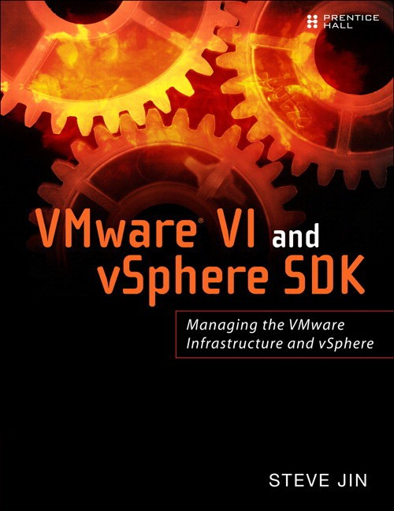
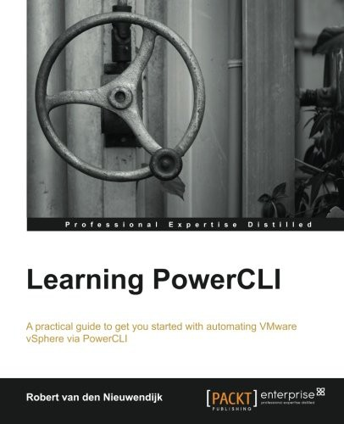
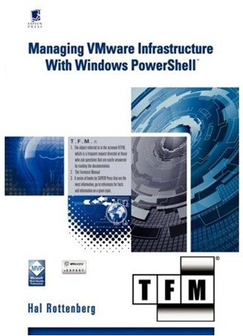
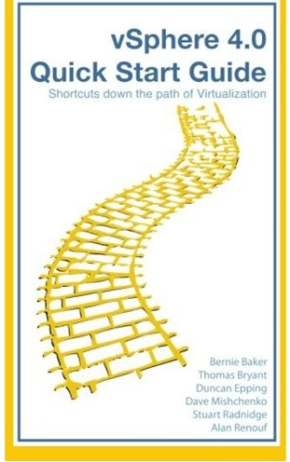
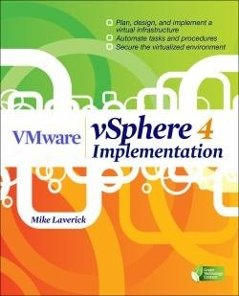
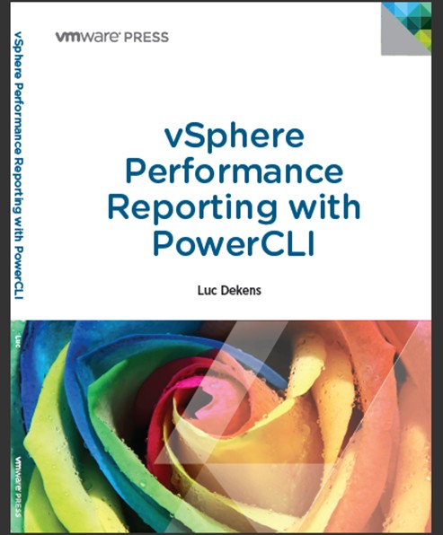
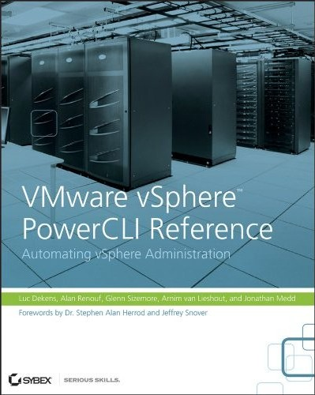
Further Reading

Slide 49

Thank You
Alan Renouf – Product Manager, VMware
Email Me - renoufa@vmware.com
VMware Blog: http://blogs.vmware.com/PowerCLI/ Personal Blog: http://virtu-al.net/
Twitter: @alanrenouf

